Slide 1
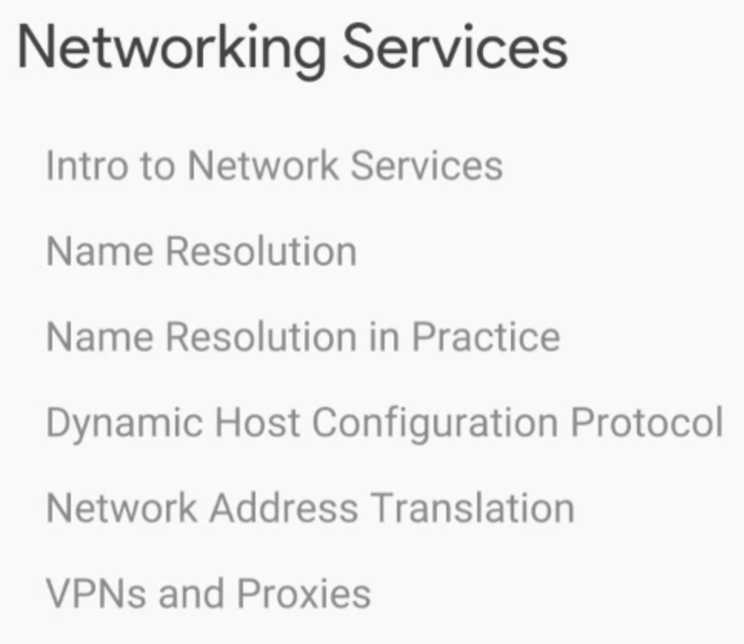

Slide 2
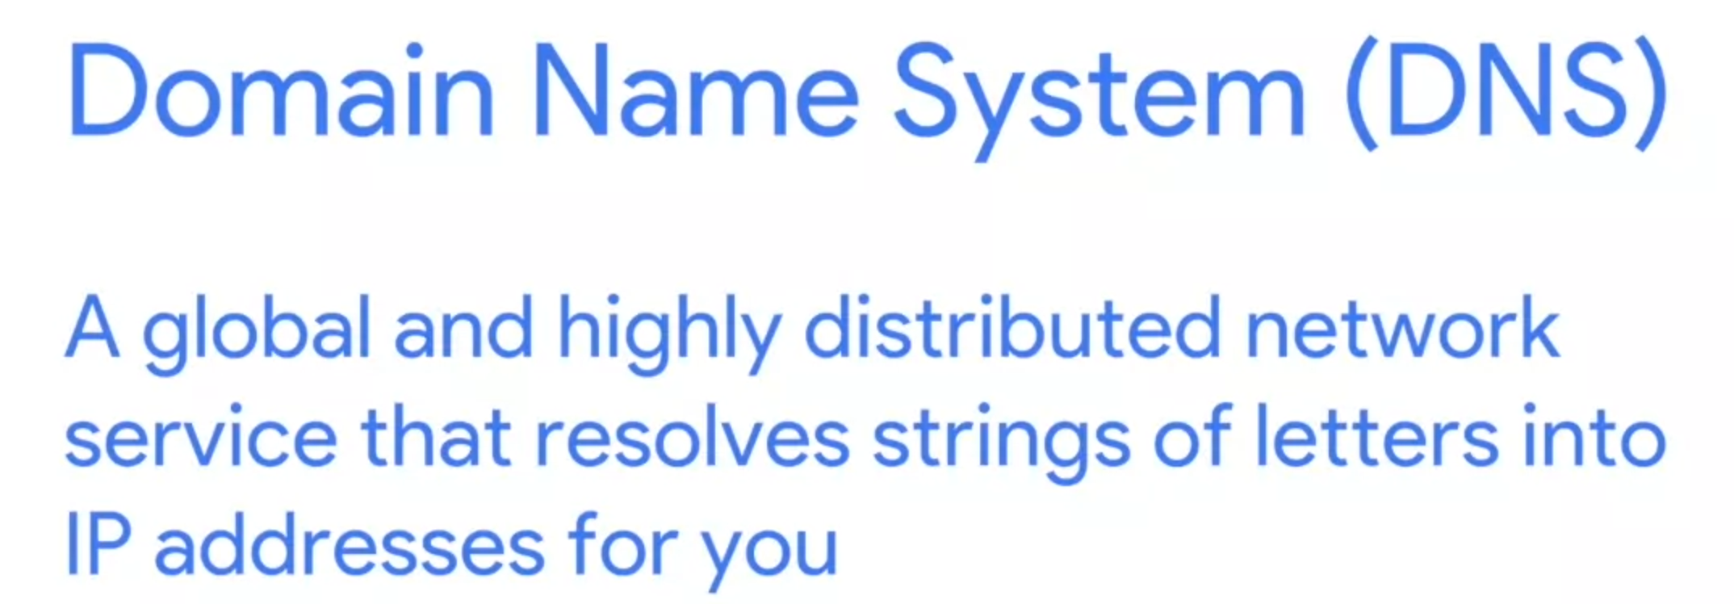
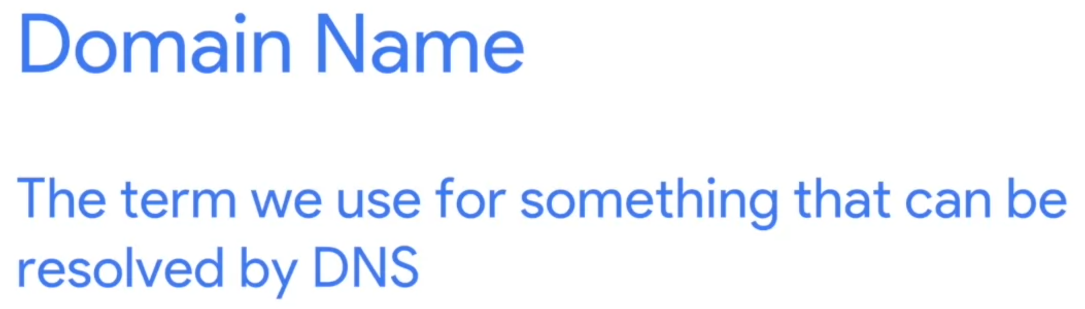
IP address is 32 bits binary numbers (e.g. 10.10.1.1), which is hard to human read (Same to MAC address, 48 bit binary numbers)

Slide 3
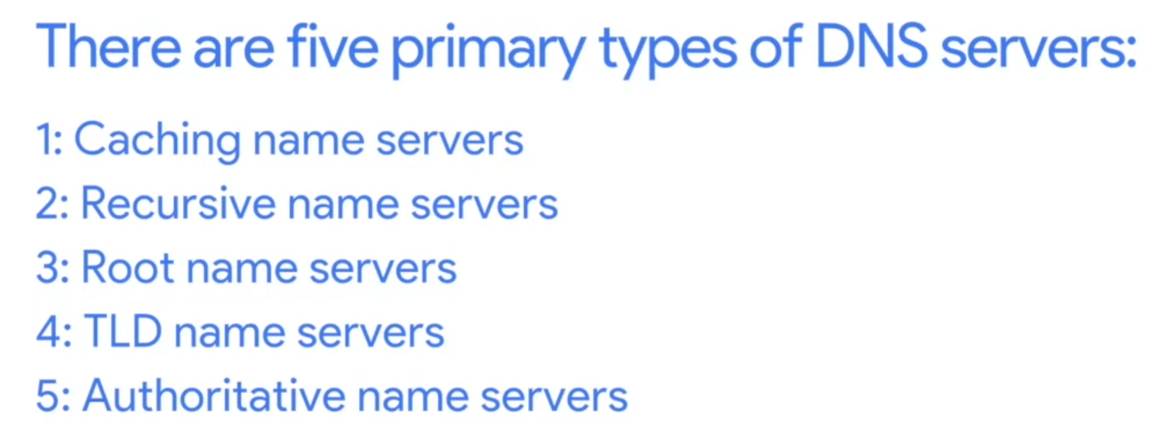
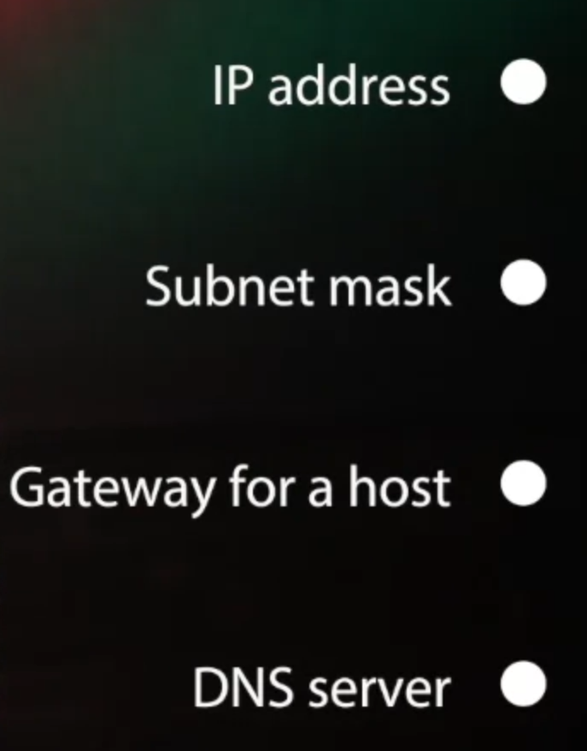

Slide 4
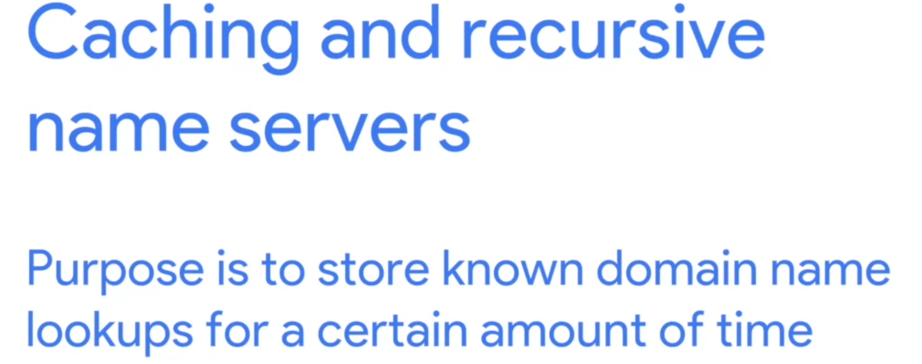
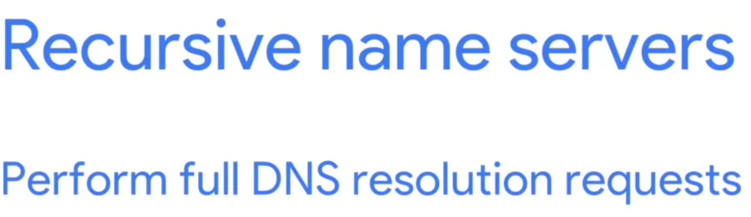

Slide 5
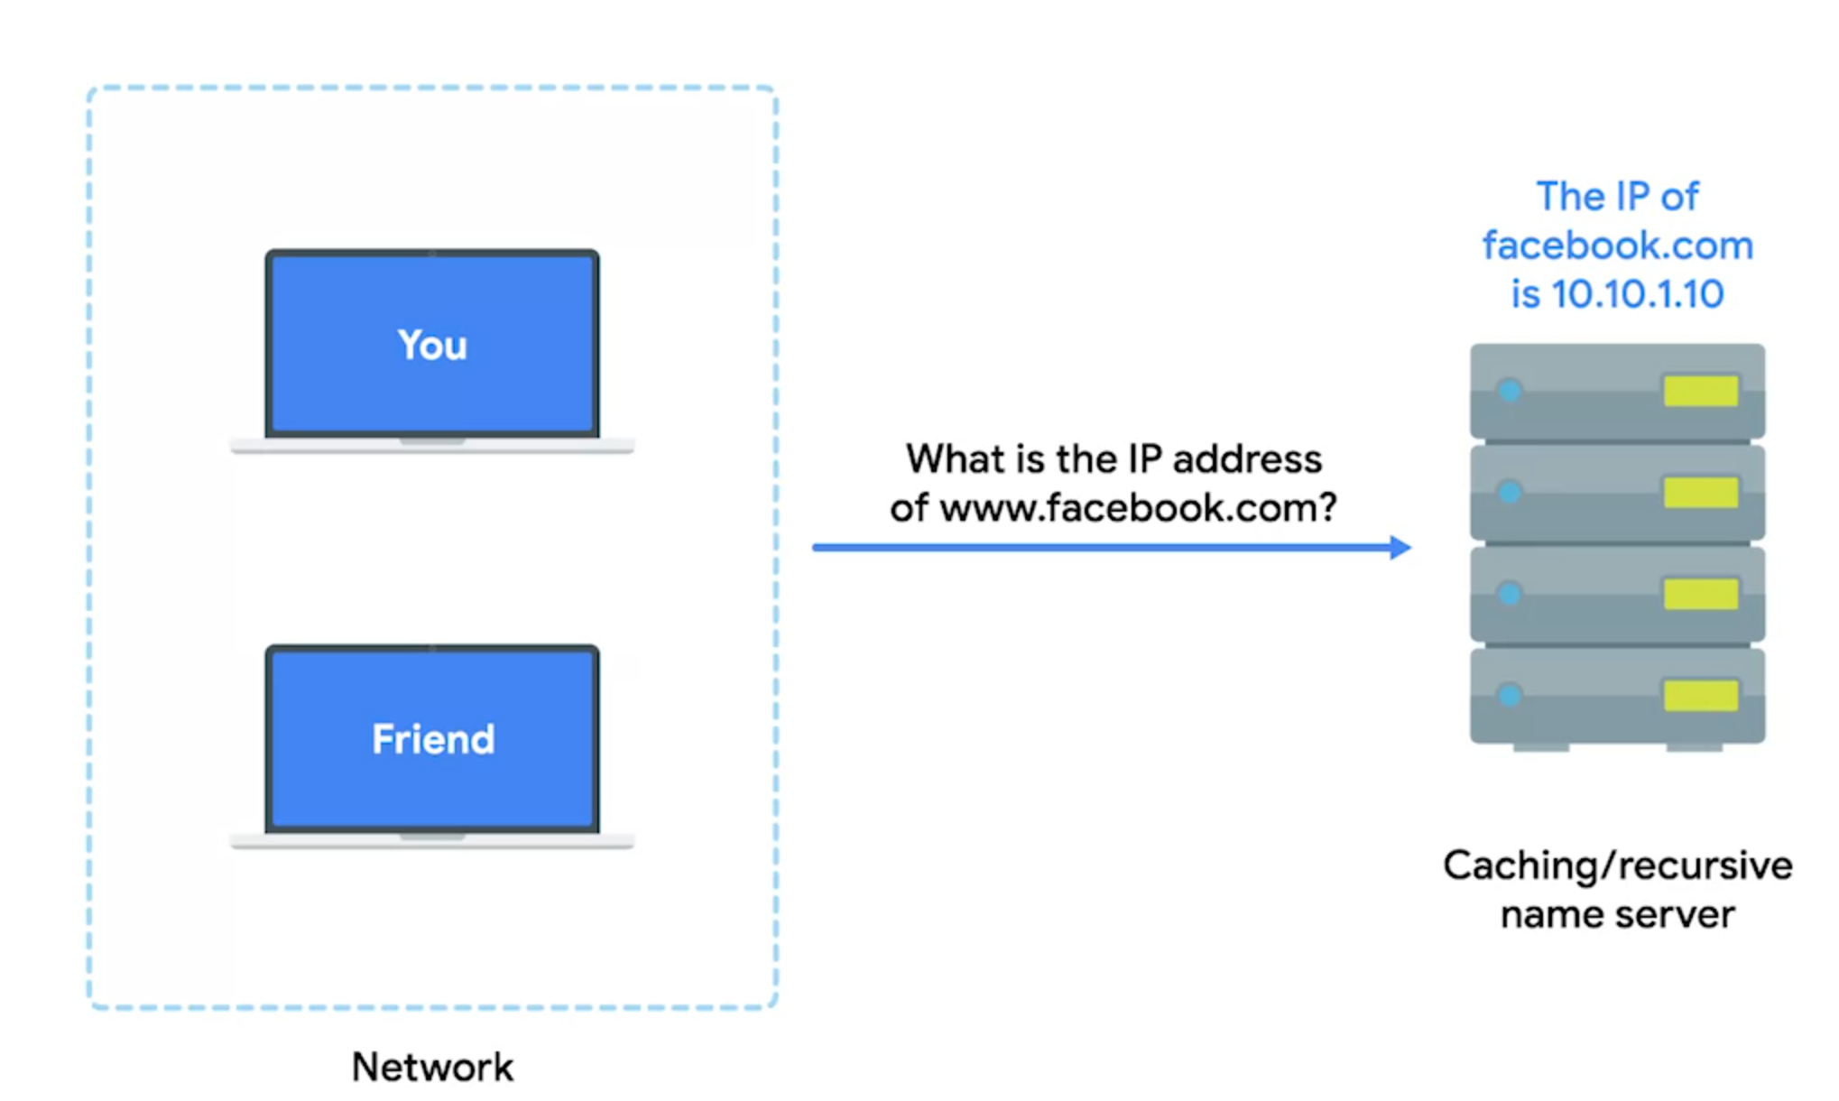
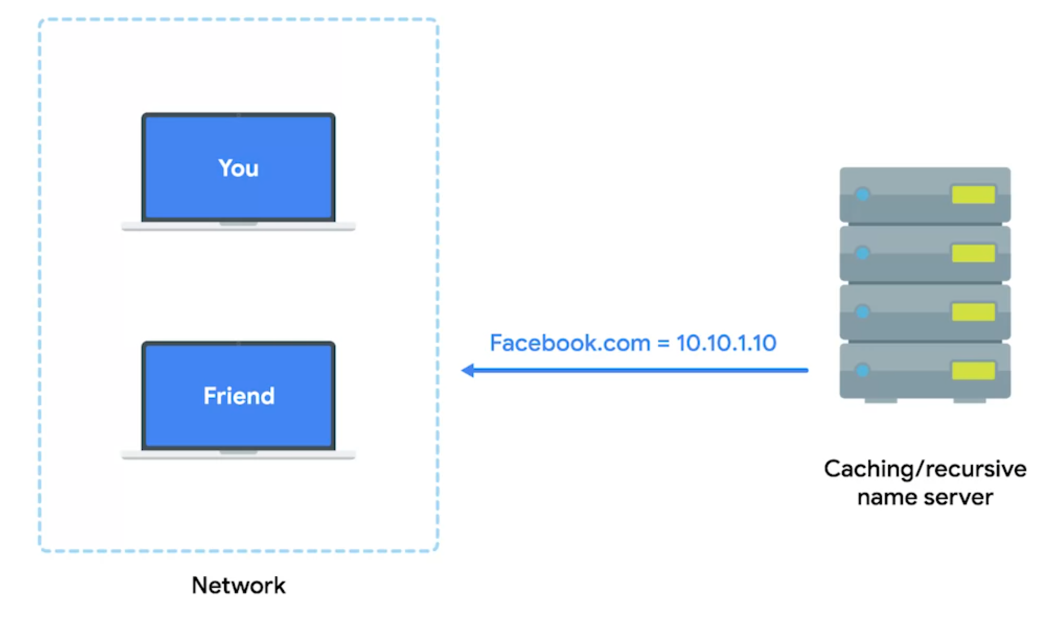

Slide 6
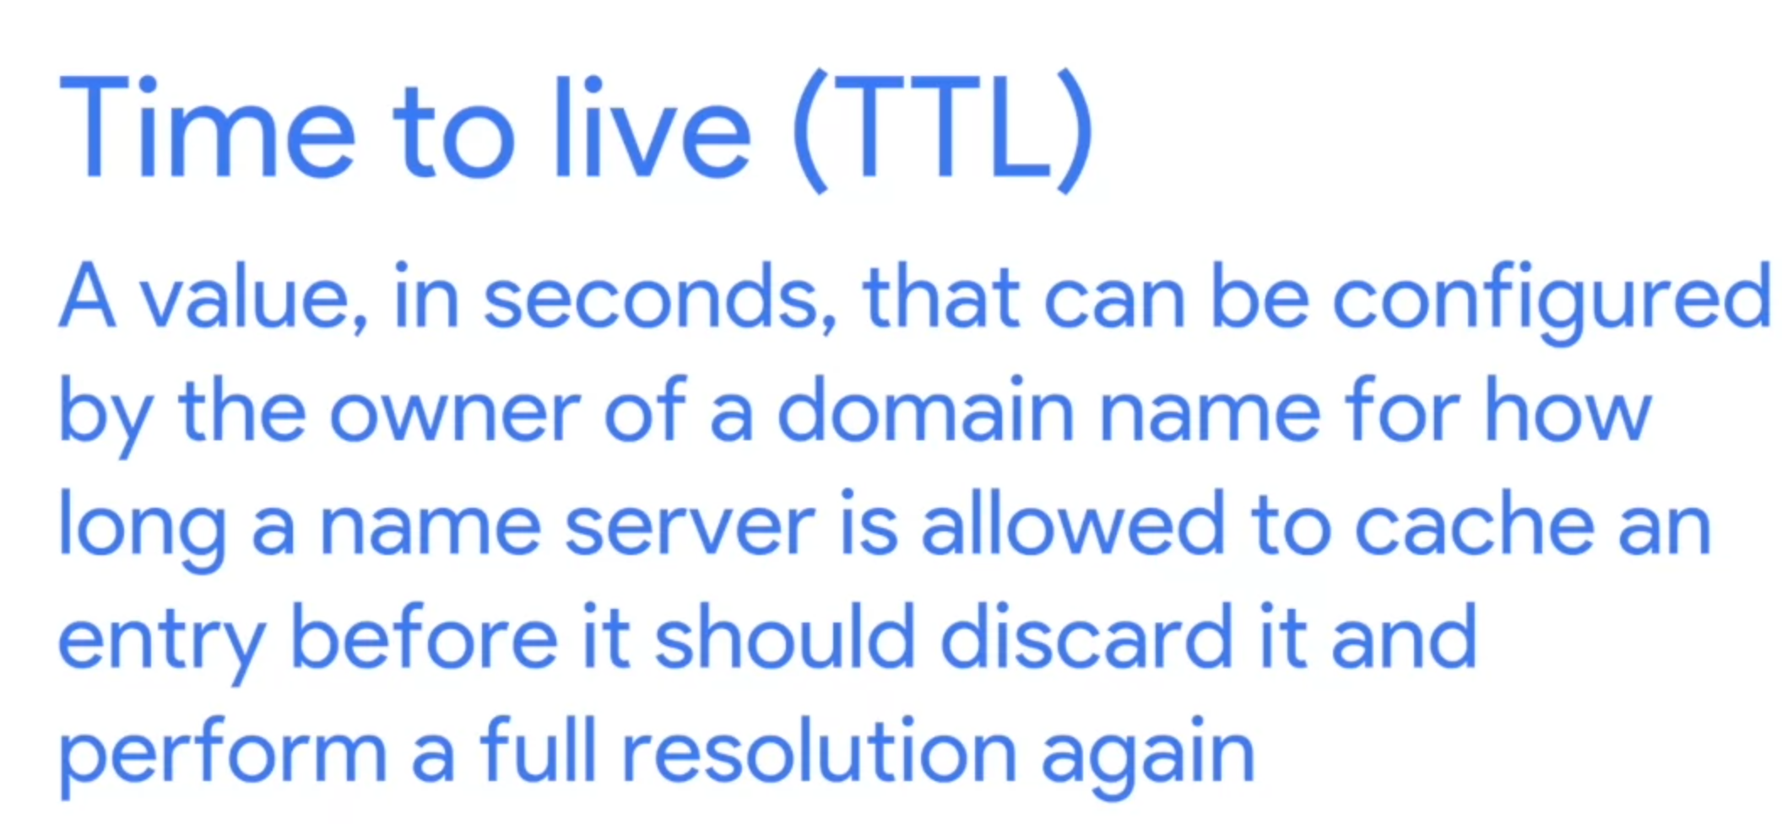
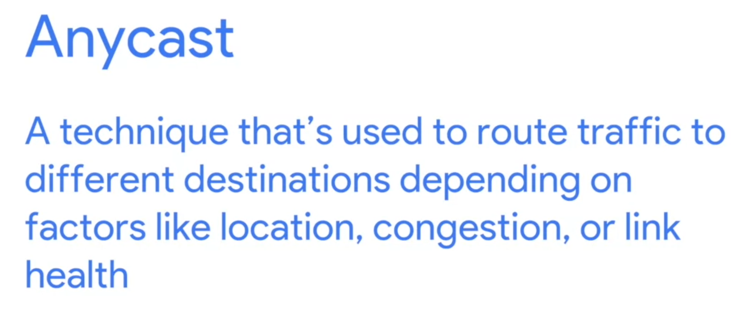
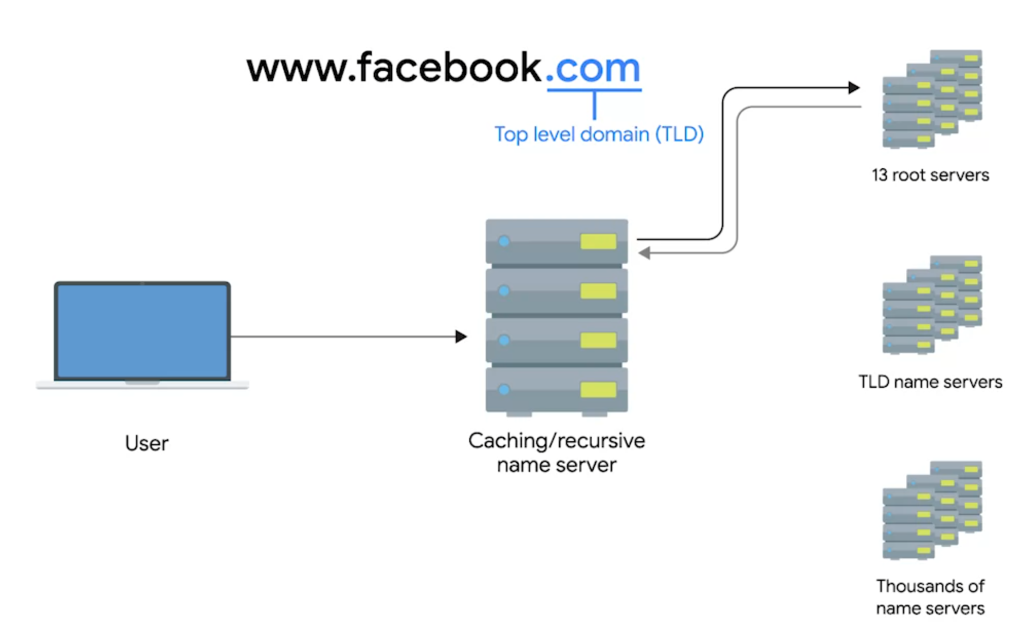
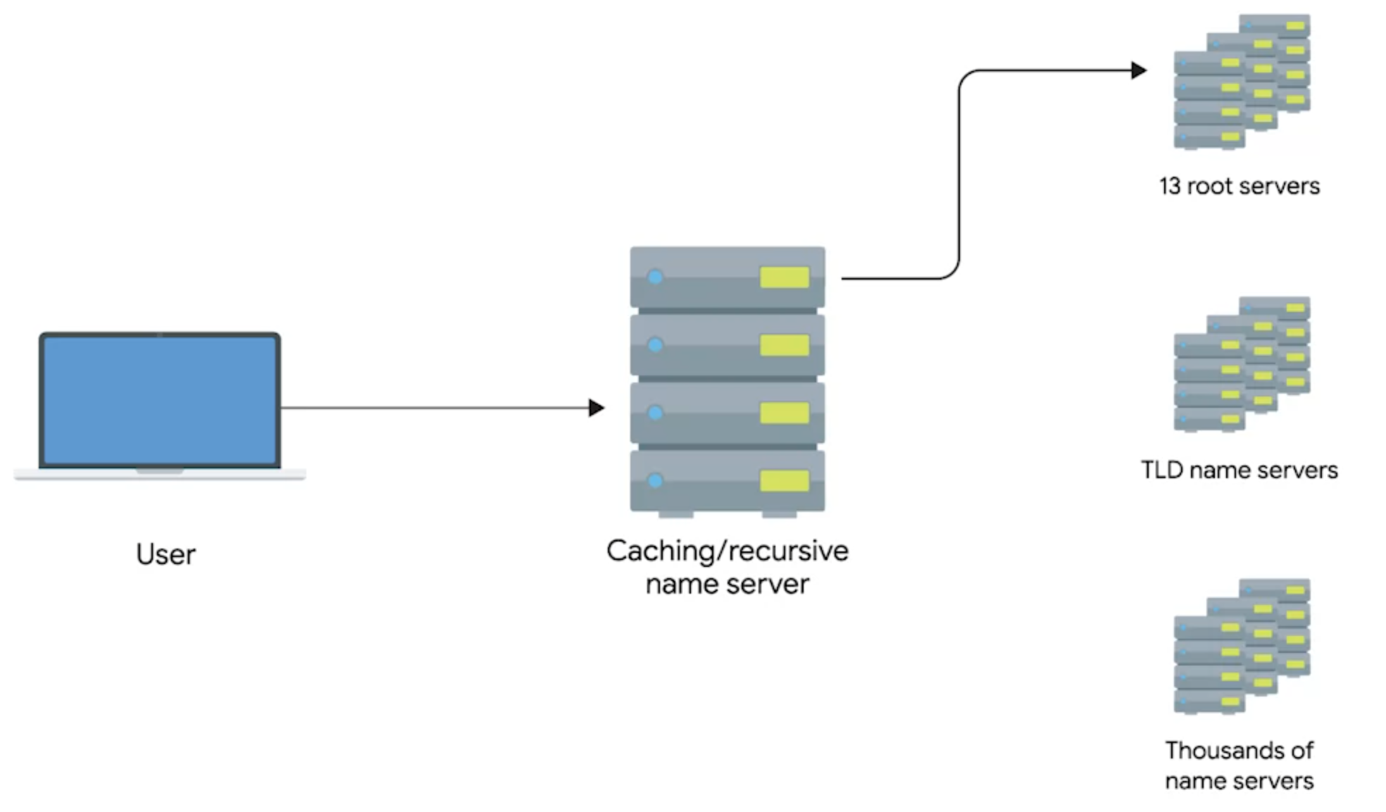
To a same IP address but actually route to different destination using parameters
How to establish a recursive name resolution
1. Connect to 13 root name server (distributed across globe via anycast)
2. Root server return the information about what’s the TLD (Top Level Domain) server it should look for

Slide 7
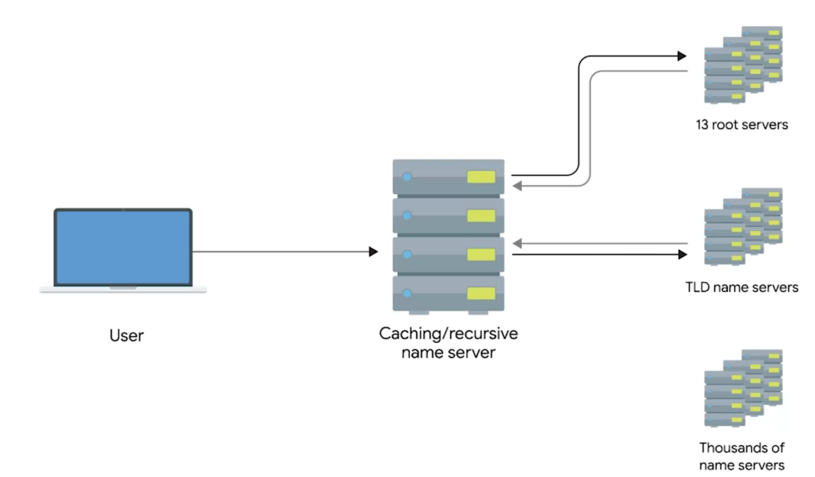
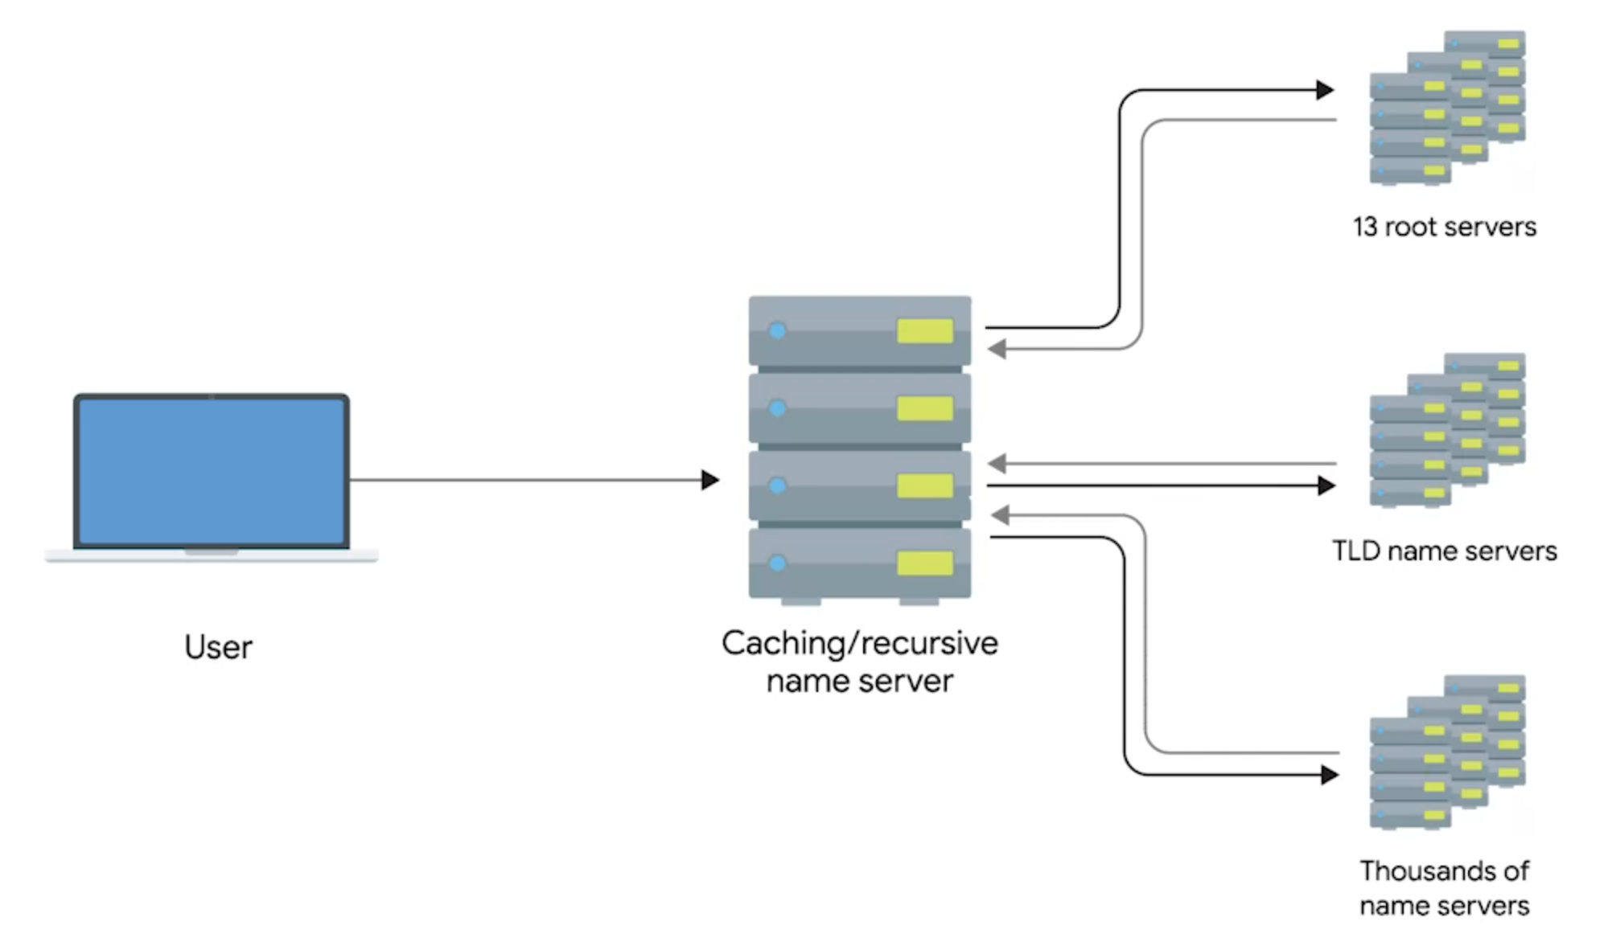
3. TLD server returns the name lookup with what authoritative name server to contact
4. Authoritative name server returns the actual IP address
DNS is a application layer that use UDP as the transportation layer
1. UDP is connectionless,

Slide 8
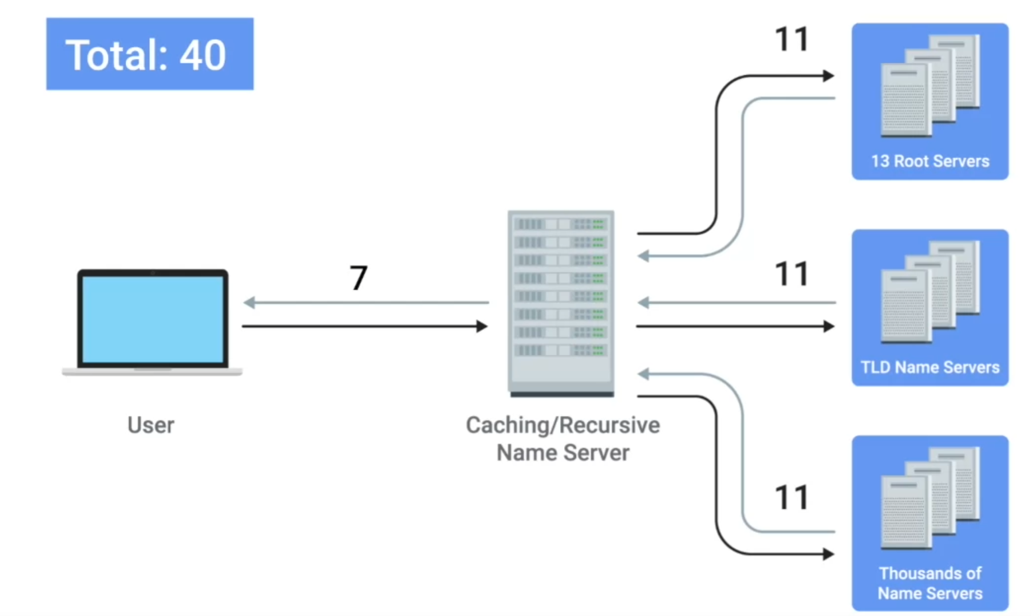
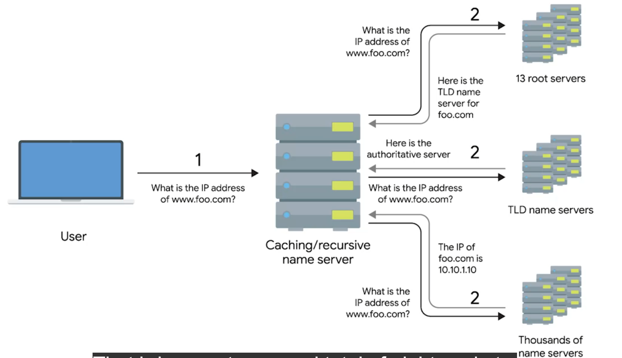
TCP protocol cause too much traffic in DNS connection, so we prefer UDP
TCP
UDP

Slide 9
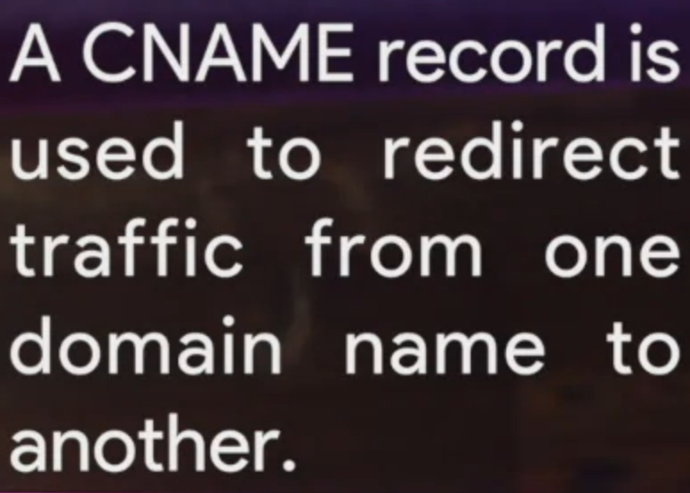
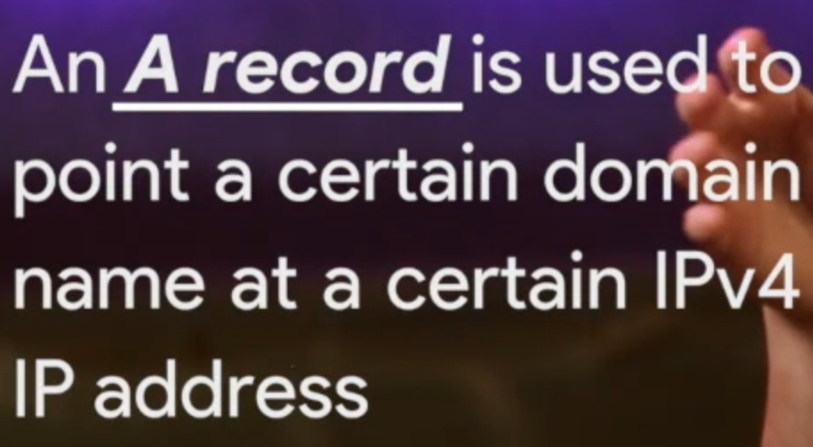
DNS Round Robin: A single domain name can have multiple A records (multiple IP address). Which is used to balance the traffic volume through those A-records.
For example, for www.google.com, it may get a lot traffic, we could set 4 A records (10.1.1.1/10.1.1.2/10.1.1.3/10.1.1.4) to this domain name,
Q-A record: same to A record (IPV4) but IPV6 address
SRV record: direct to service server
Txt record:
CNAME (canonical name) use to redirect google.com to www.google.com
MX-record (mail exchange) : deliver email to mail server

Slide 10
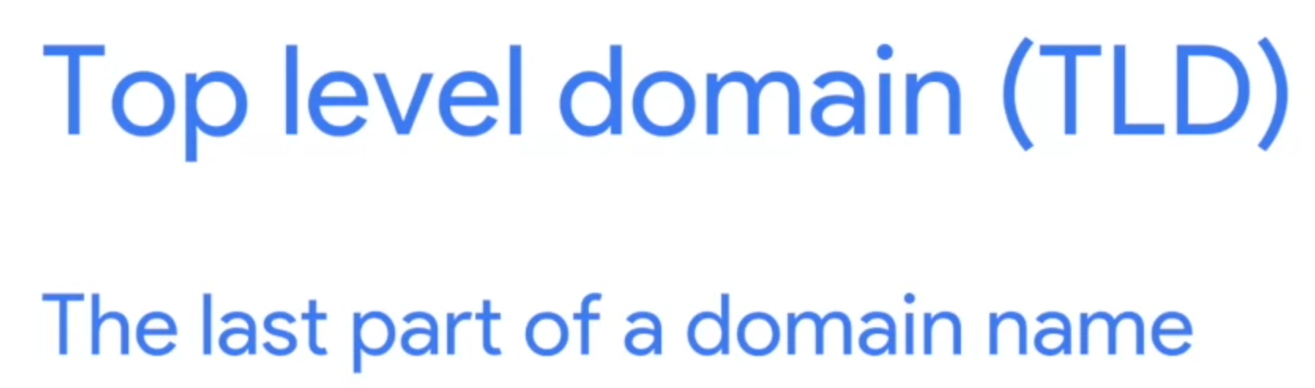
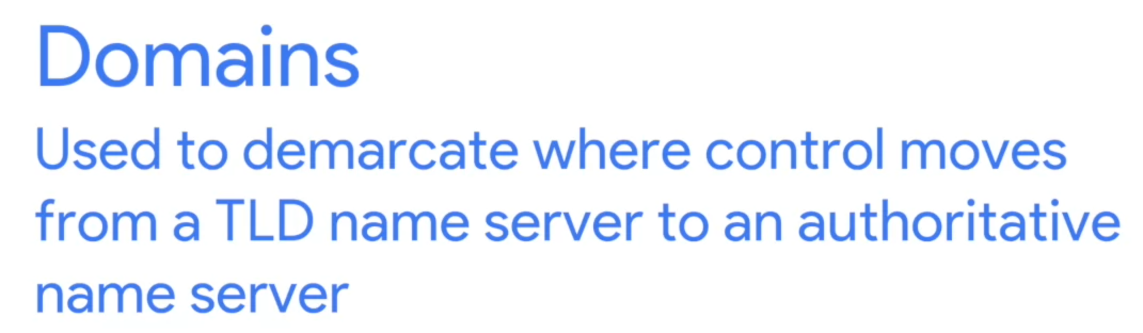
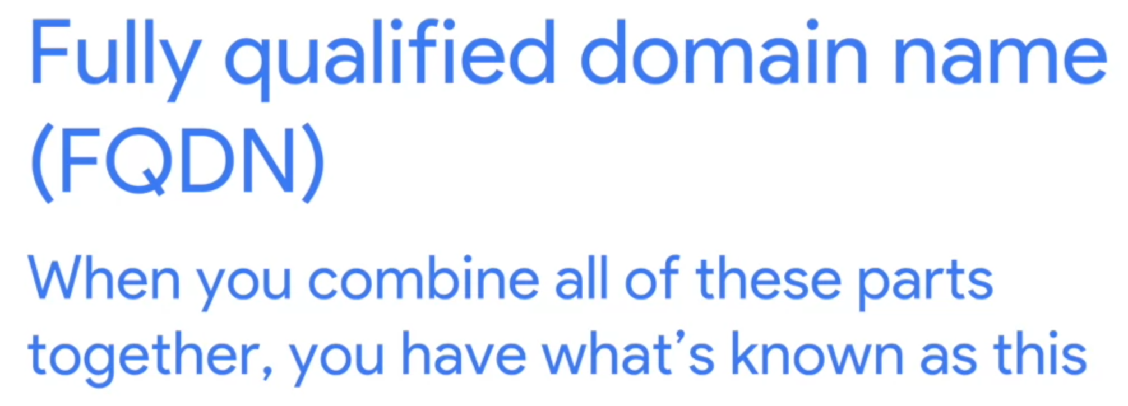
A DNS address is composed by 3 parts:
Take www.google.com as the example, this last one is TLD (.com), the middle part called domain (google). WWW is the subdomain, also called host name
Examples:
.de
.edu
.com
.cn
.net
There are several vanity TLD hold by ICCAN(The Internet Corporation for Assigned Names and Numbers)

Slide 11
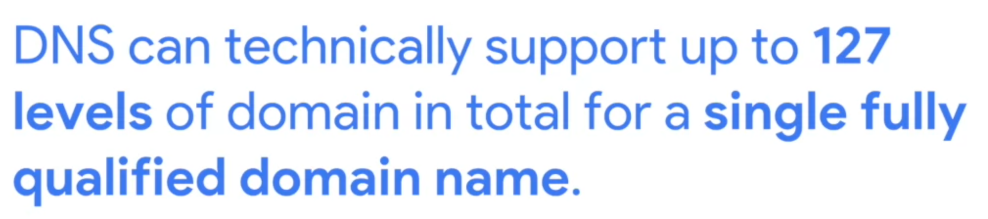
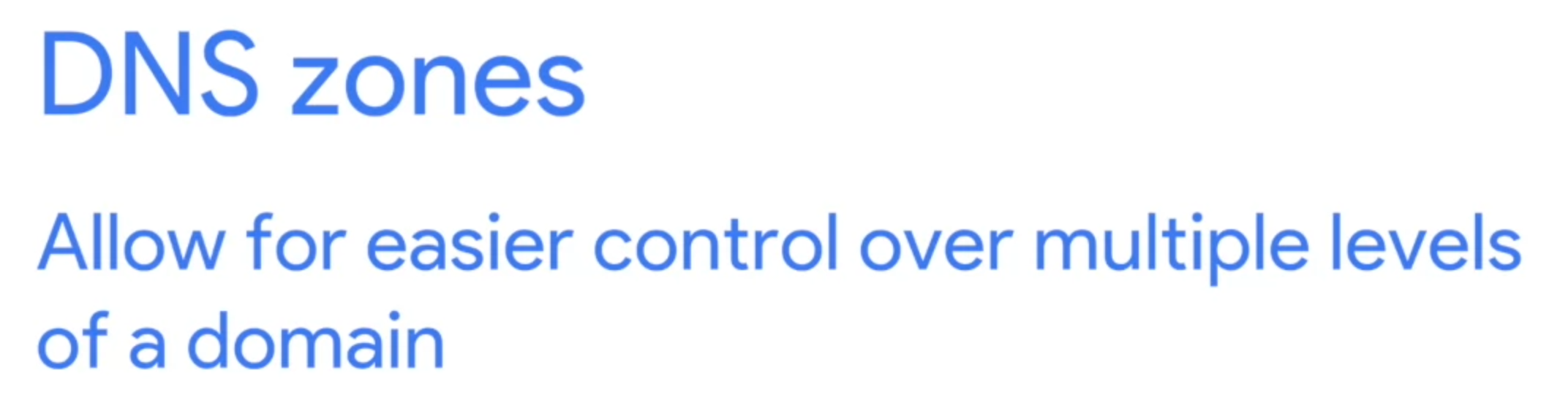

Slide 12

If we separate three office into their own zone, we need to set up four authoritative server. One of largecompany.com, and one for each subdomains.

Slide 13
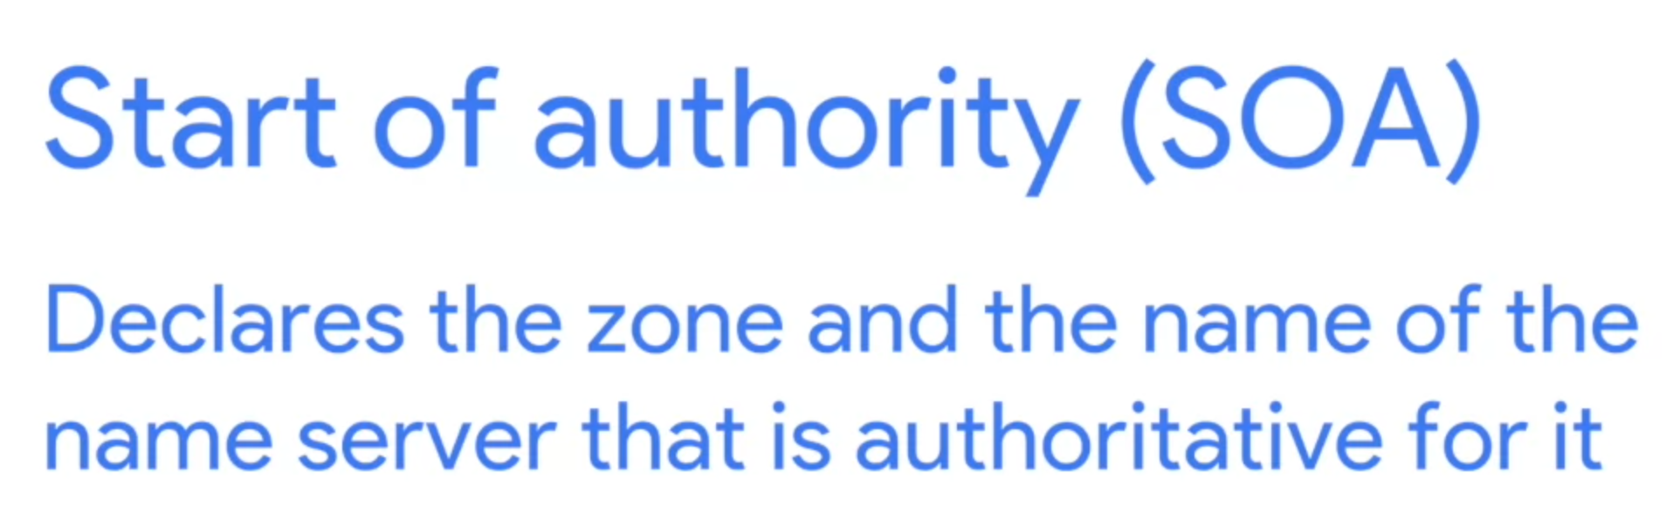
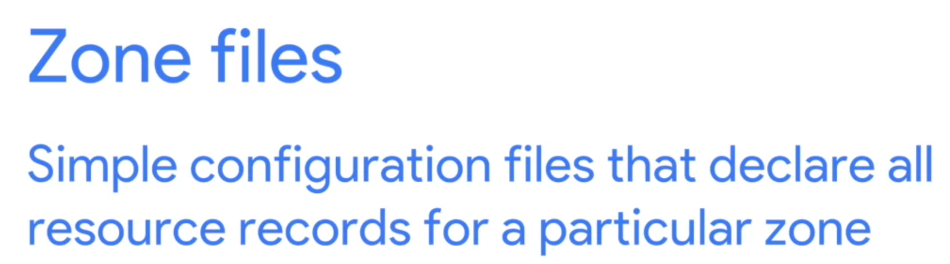
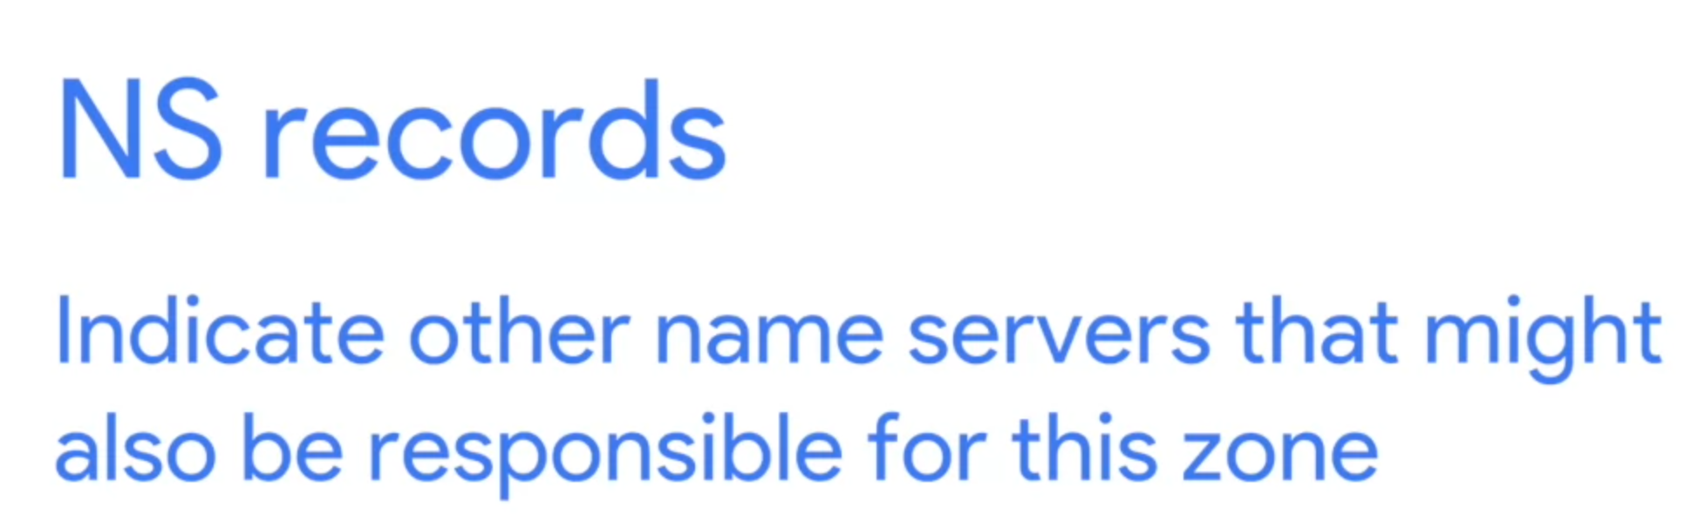

Slide 14
